Slide 1


Fintech Risk Management Sleepless Nights for Central Bank Governors
Presentation at EU Fin-Tech Horizon 2020 final workshop
JUNE 18, 2021
Ashraf Khan
Monetary and Capital Markets Department
© The Sociable, 2016

Slide 2
Overview
The Pervasiveness of Fintech
Risks – Strategy, Policy, Operational
IMF Experience: Surveillance and Technical Assistance
An Example: CBDC
Avoiding Sleepless Nights for Governors
DISCLAIMER
The view expressed here are those of the IMF’s staff, and not necessarily those of the IMF’s management or Executive Board.
COPYRIGHT
This material is the property of the IMF and is intended for use only by IMF staff.

Slide 3





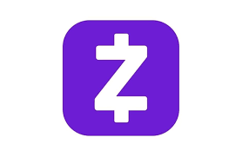











The Pervasiveness of Fintech – Part I
All icons / logos are owned by their respective trademark owners.

Slide 4
The Pervasiveness of Fintech – Part II
BIS and French and Swiss central banks announce joint CBDC project
(June 10, 2021)
El Salvador to make bitcoin legal tender (June 8, 2021)
Thailand’s central bank picks G+D for retail CBDC project (June 3, 2021)
RBNZ’s Orr admits ‘shortfalls’ on cyber security
(June 1, 2021)
Dominican Republic’s central bank plans financial innovation hub
(May 28, 2021)
Source: centralbanking.com

Slide 5
Central Bank Strategy and Policy Risk
Strategy & Policy Risk:
Monetary policy & operations
Financial Market Infrastructure
FX Reserve Management
Financial Inclusion
Financial Supervision
Financial Integrity
Cash Currency Management
With the expansion of central bank mandates, comes an increasingly broad risk landscape…

Slide 6
Central Bank Operational Risk
1) Information Technology (IT)
Software (developed in house, or externally?)
Hardware (quality demands and assurance)
Cyber-security (human error, red teaming)
Data-management (digitization, databases, backups)
4) Human Resources (HR) & Organization
Expertise & training
Remuneration policies
Organization chart / roles & responsibilities
Reporting lines
5) Operations
Business Continuity Management
Building services, maintenance, drivers & cars, (armed) security services, etc.
2) Outsourcing
Software (see above) & cloud computing
Asset management & pension fund management
Currency management (cash delivery)
3) Project Management
Central Bank Digital Currencies development & implementation
Sandbox/Innovator organization & operations
6) Legal
Legal protection of Board members and staff
Ombudsman / Whistleblowing
Compliance with laws and regulations (inc. AML/CFT and Code of Ethics)

Slide 7
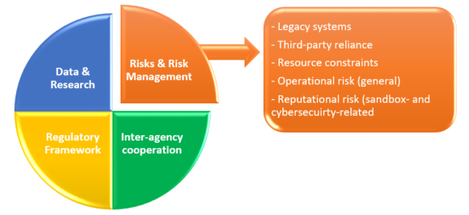
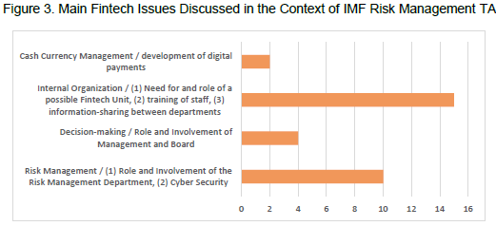
IMF Experience: Surveillance and Technical Assistance
… and digital risks are reflected in IMF technical assistance and surveillance

Slide 8
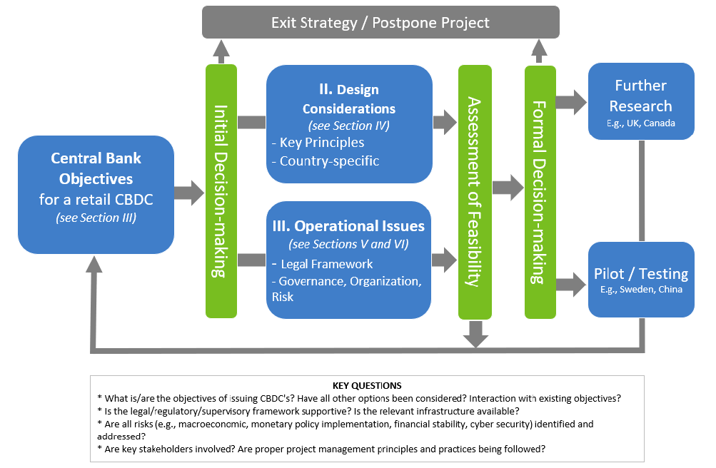
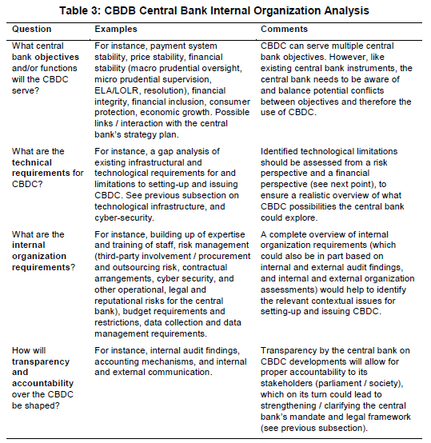
An Example: Central Bank Digital Currency
Table 3: CBDC Central Bank Internal Organization Analysis
Kiff, J. e.a., 2020, A Survey of Research on Retail CBDC. IMF Working Paper 20/104.

Slide 9
Avoiding Sleepless Nights for Governors – Recommendations for Central Banks
ADDRESS RISKS: Have a dedicated, independent risk management function
STAY ON TOP: Ensure “fintech fit and proper” Governors, Board members, and staff
GET DATA: Have clear internal reporting lines to the Board and Management on fintech and cybersecurity risks / issues
AVOID SILOS: Ensure an integrated fintech and cybersecurity approach between business departments (including financial supervision and IT), risk, and audit
BE VIGILANT: Improve cyber resilience and security posture
Khan, A., Malaika, M., 2021, Central Bank Risk Management, Fintech, and Cybersecurity. IMF Working Paper.

Slide 10
Thank you
akhan4@imf.org
Khan, A., Malaika, M., 2021, Central Bank Risk Management, Fintech, and Cybersecurity. IMF Working Paper 21/105
Kiff, J. e.a., 2001, A Survey of Research on Retail CBDC. IMF Working Paper 20/104.
Upcoming event: EU Fin-Tech Horizon 2020 Seminar on Central Bank Risk Management, Fintech, and Cybersecurity (September 30, 2021)

